Slide 1
Pre-Launch Check-in
Benchmarking Mid-Level Vision
8.30.22

Slide 2
Itinerary
Pilot results overview
Model Plans
PSGNet
Eisen
Transformers
DINO
Slot Attention Models
Depth / Normal – specific models

Slide 3
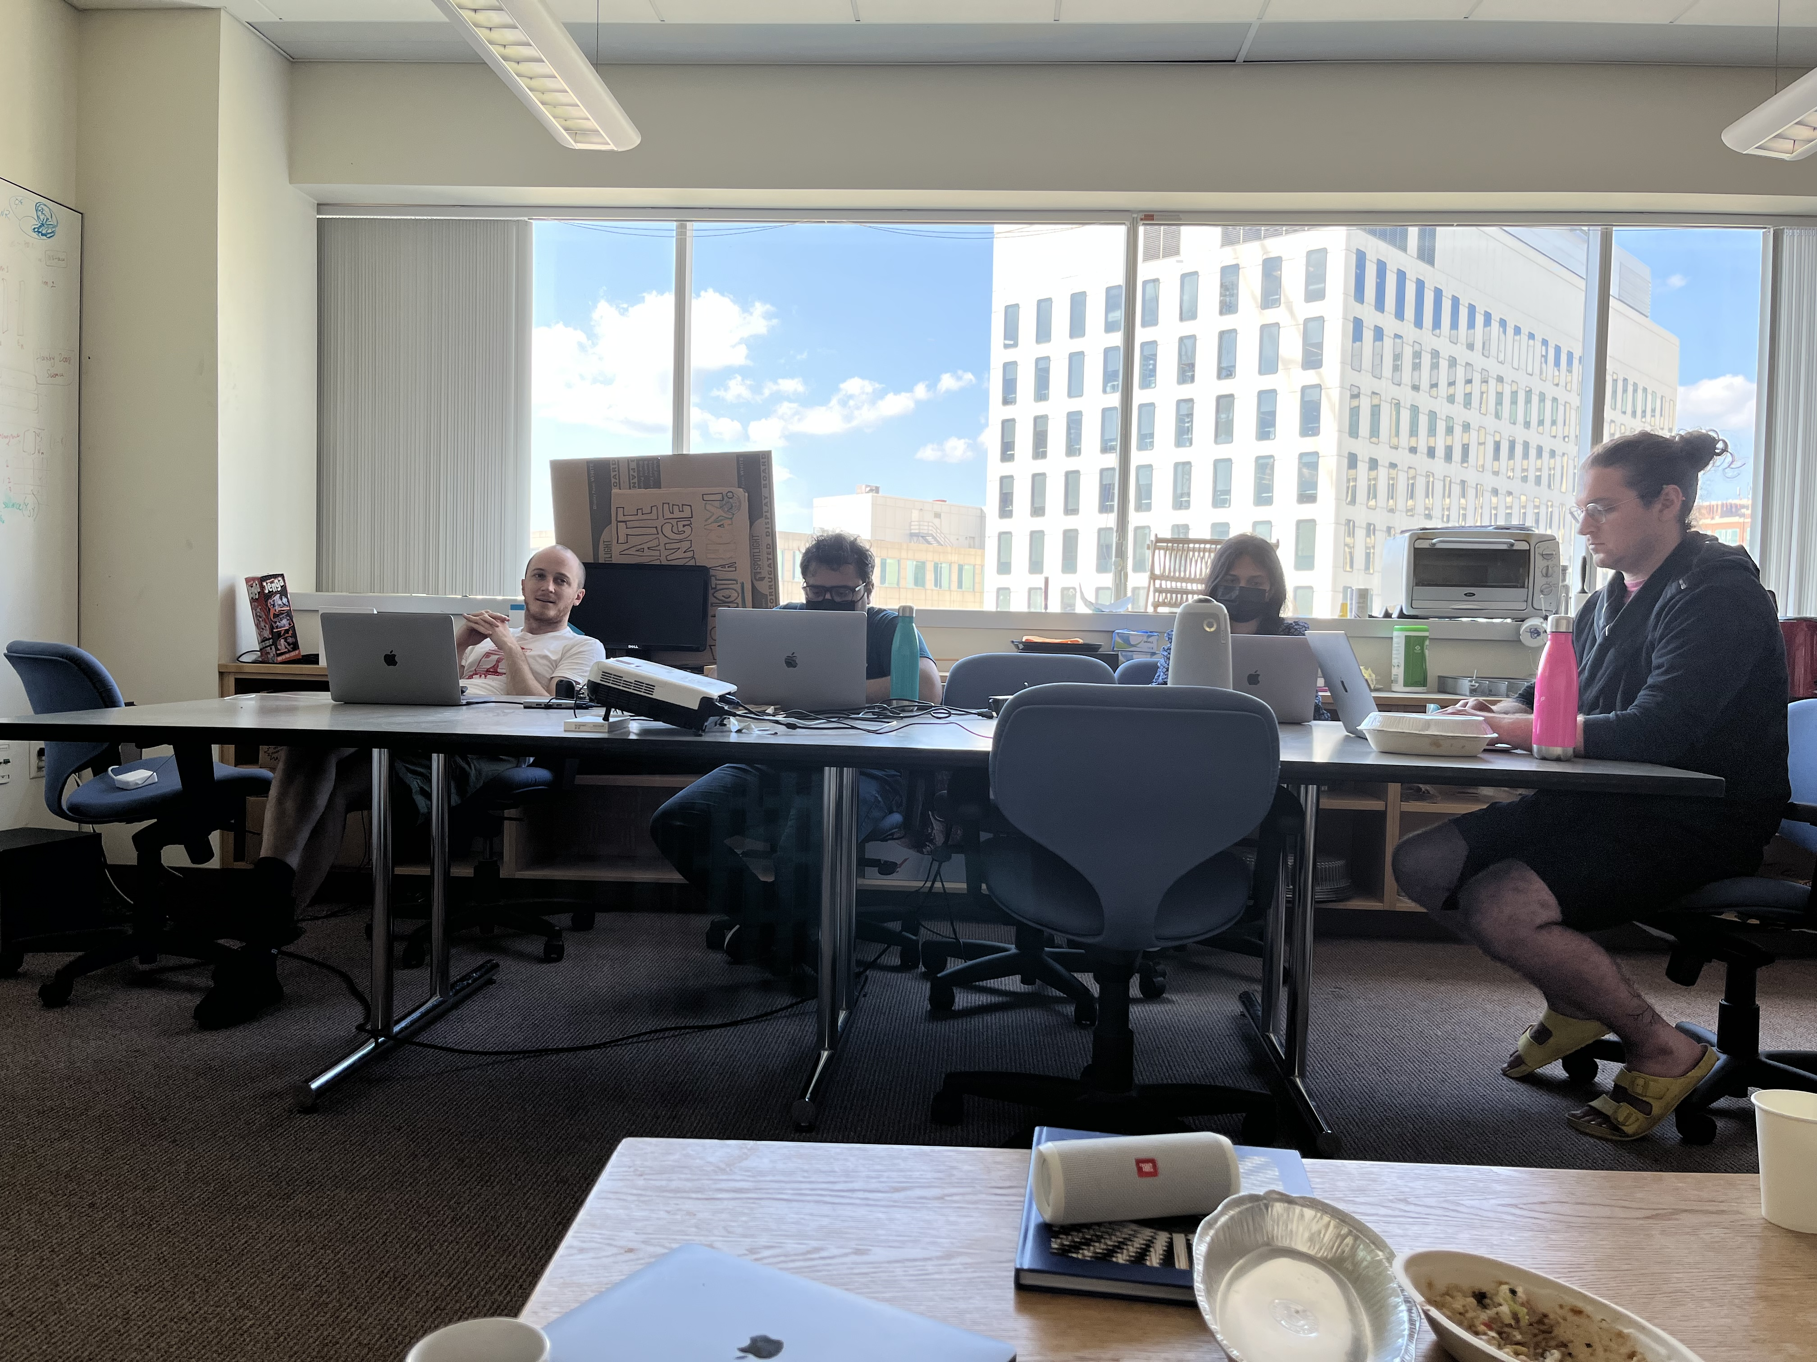
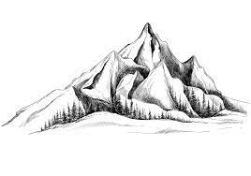

Motivation
Humans perceive rich and stable structure in all sorts of scenes
This seems to contrast with many deep learning models
One possible point where the two differ is at the so-called “mid-level” of vision
Low level characteristics of the world around us, like depth, orientation, class-agnostic object segmentation
How can we probe humans and machines to compare their respective mid-level representations across a wide variety of domains?
<feedback db> Add set of well known failure cases to really motivate why this is important – would be nice to understand those failures
Humans can do all these tasks across all sorts of scenes
Deep learning generalization is pretty poor, unlike human vision
Stable diffusion / diffusion denoising models latent space representation worth testing?

Slide 4
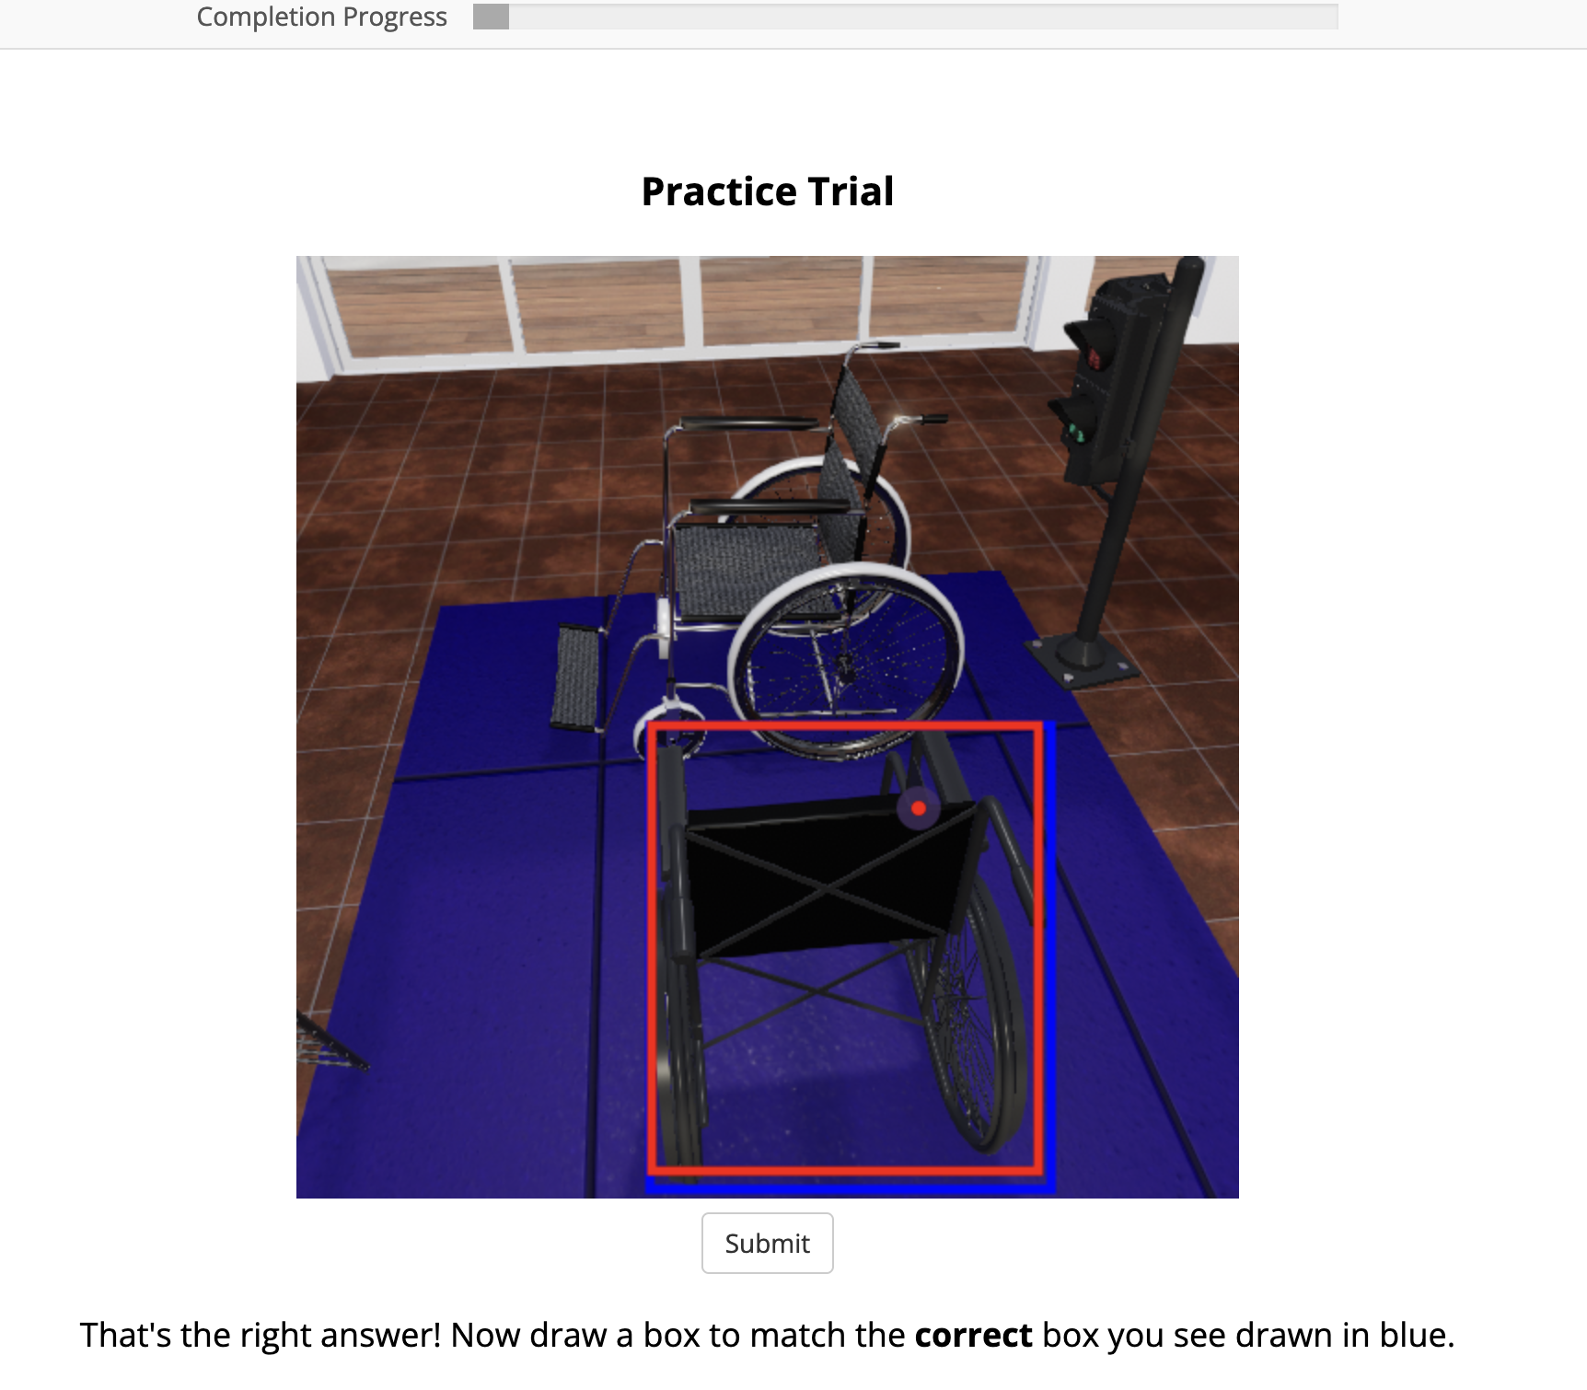
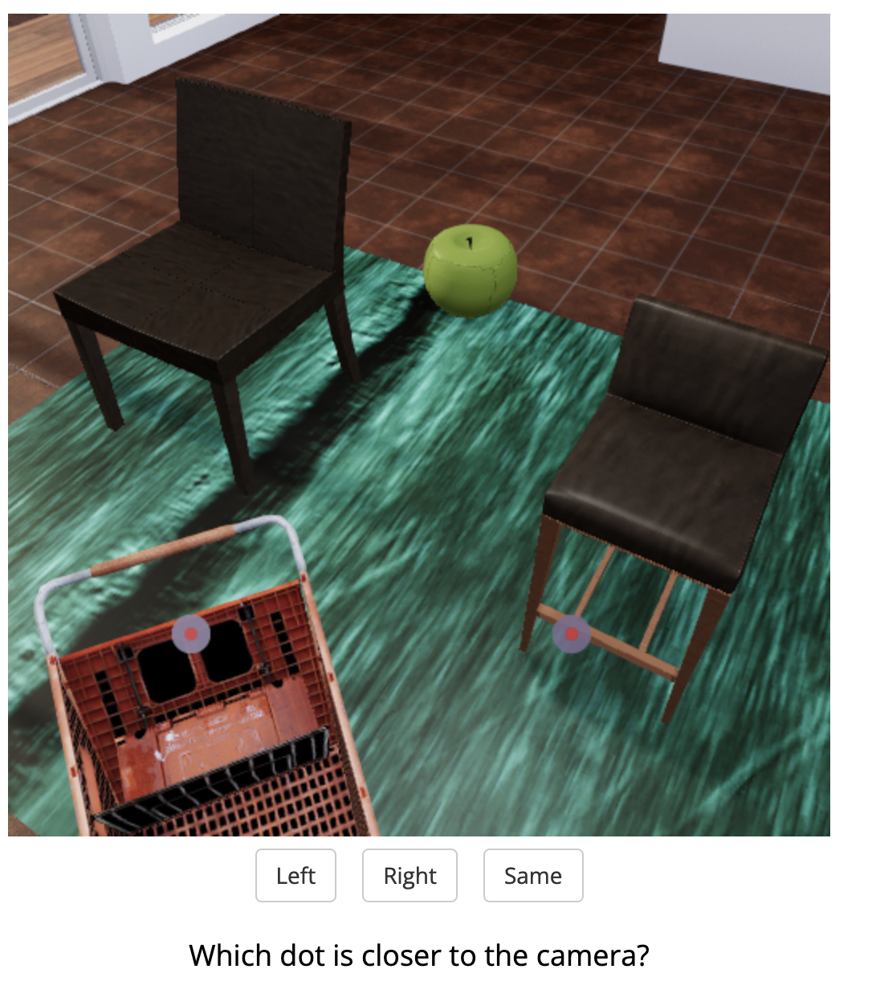
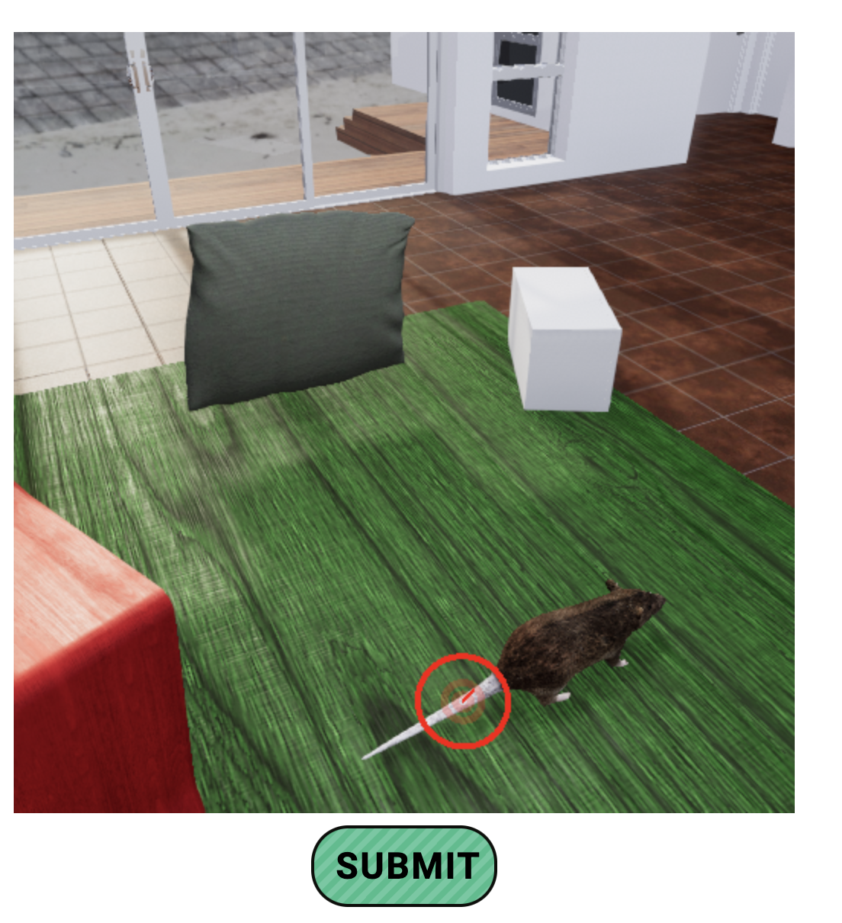
Experiment Goals
Probe various mid-level representations:
Object localization / segmentation
Depth Estimation
Surface Normal Estimation
Across a variety of datasets:
TDW
Hypersim
Gestalt-style objects
NSD

Slide 5
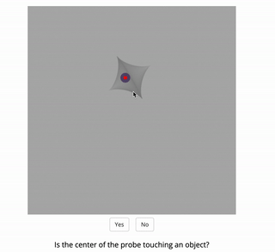
Object Localization

Slide 6
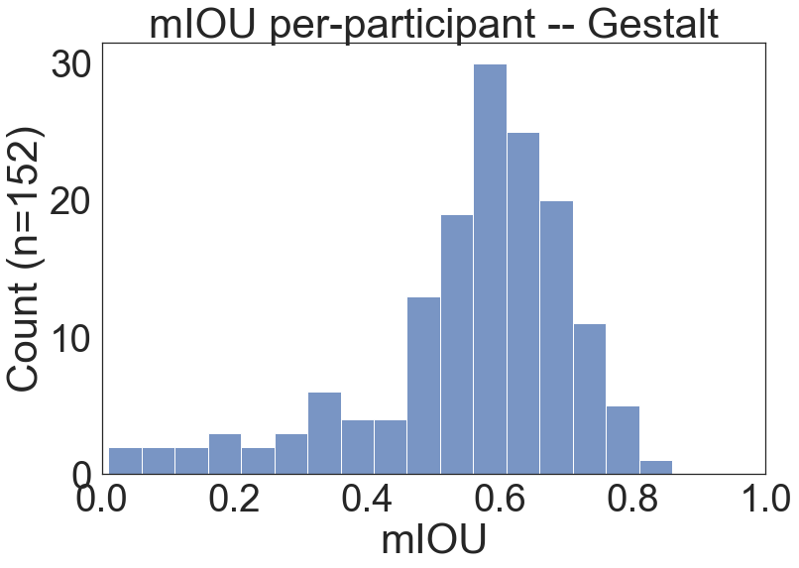
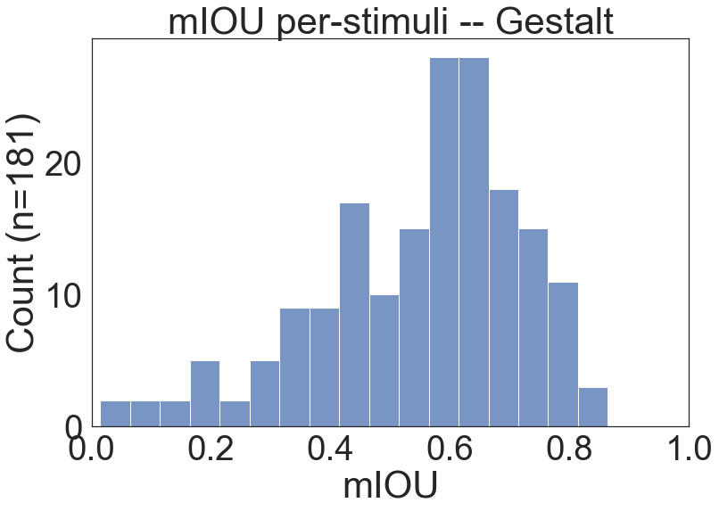
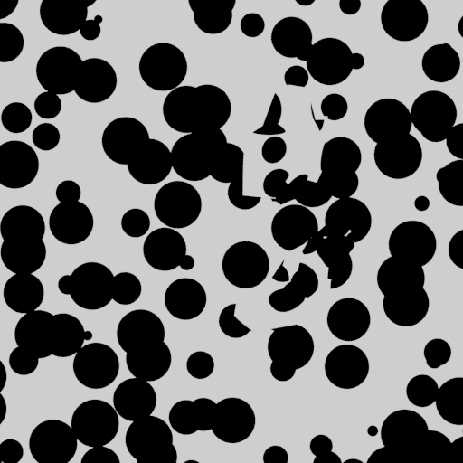
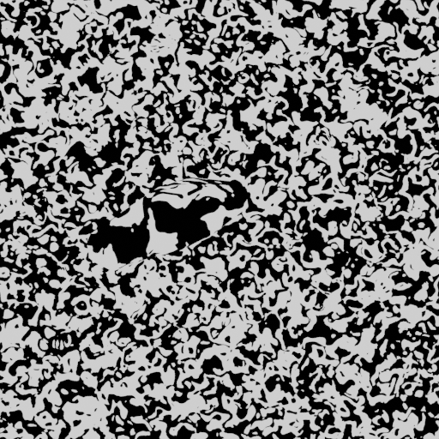
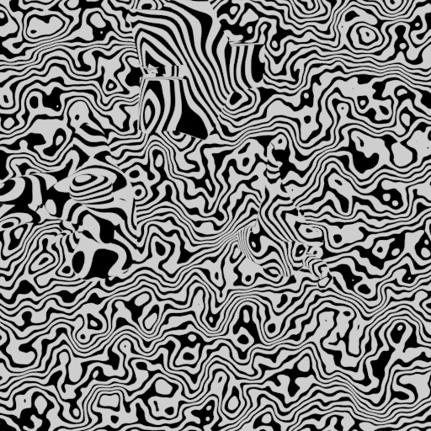
Object Localization - Gestalt

Slide 7
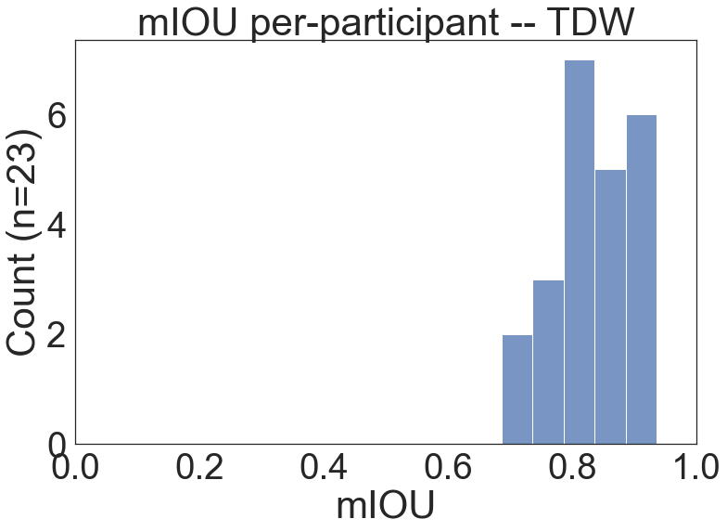
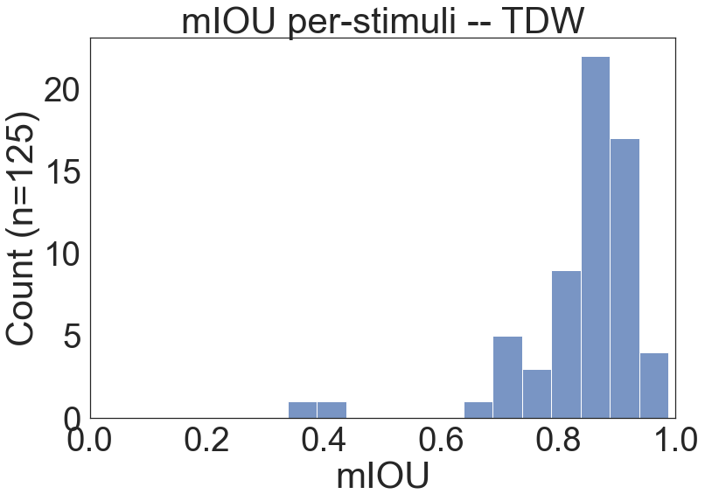
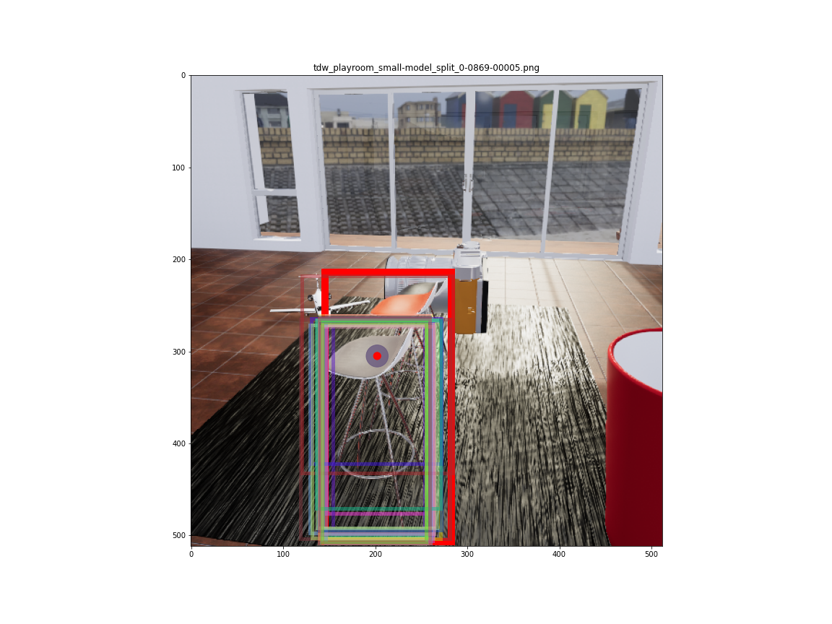
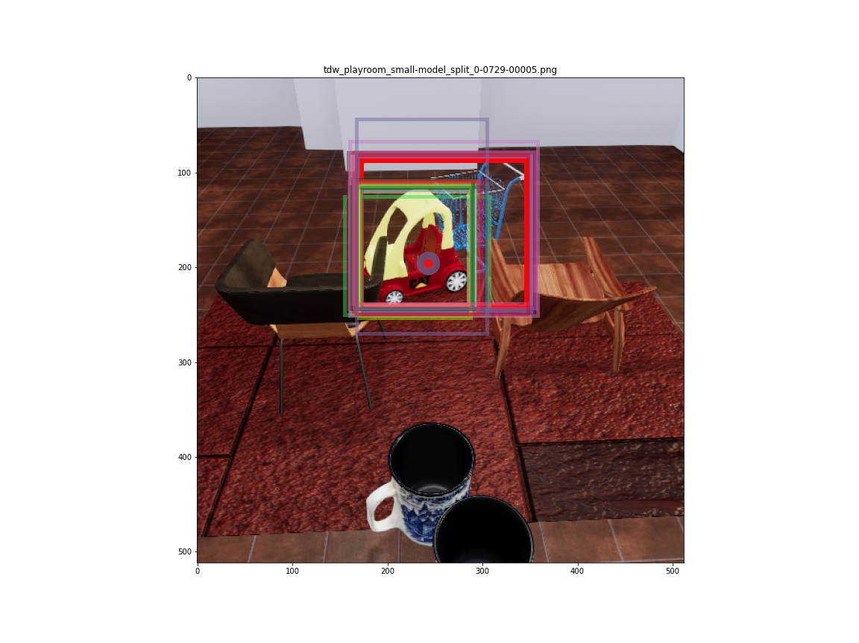
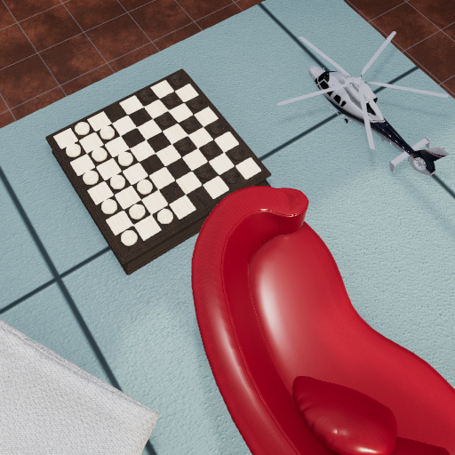
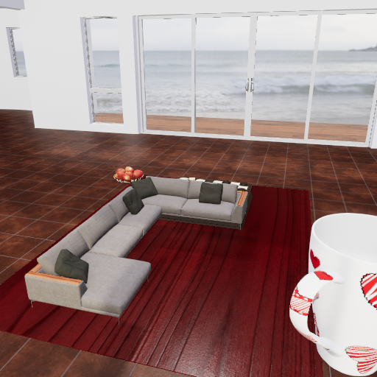
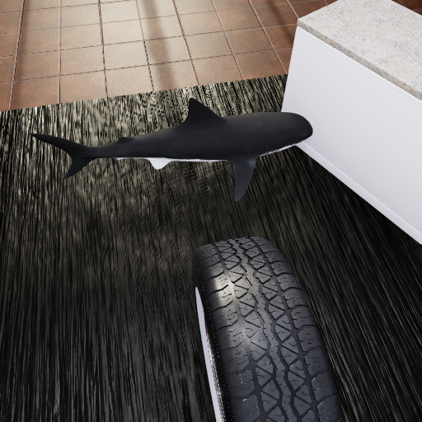


Object Localization - TDW

Slide 8
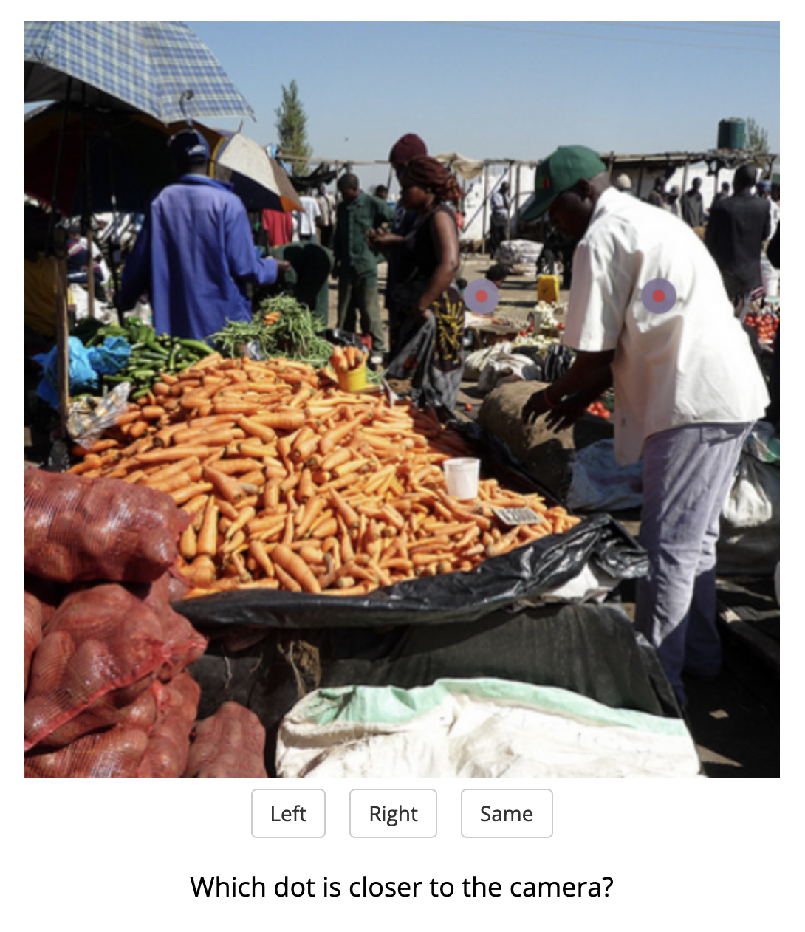
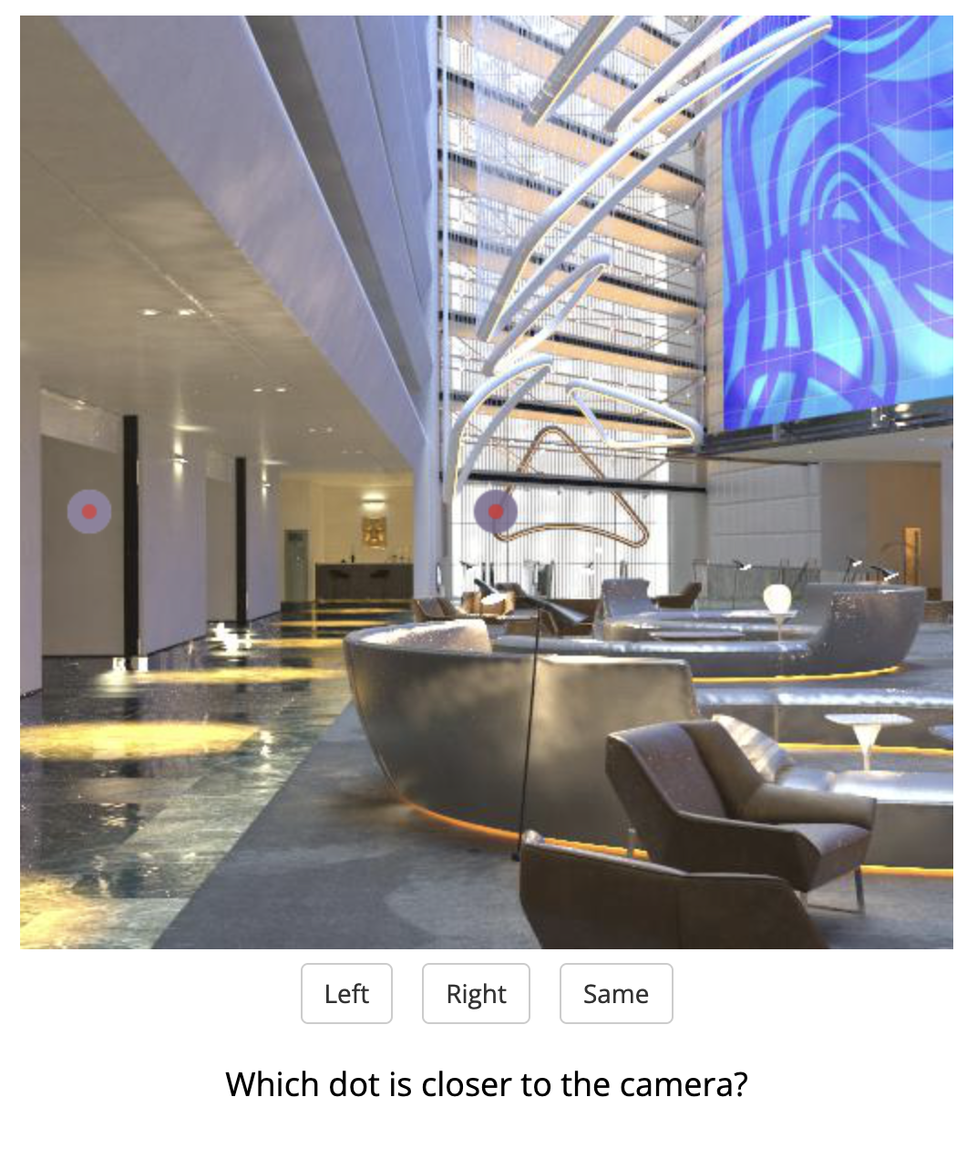
Relative Depth Estimation

Slide 9
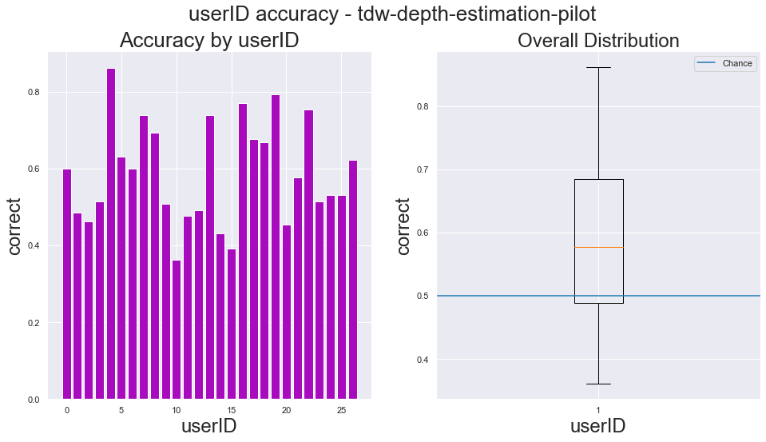
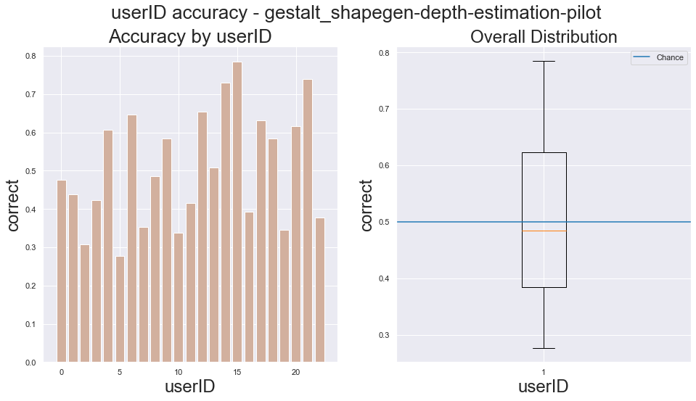
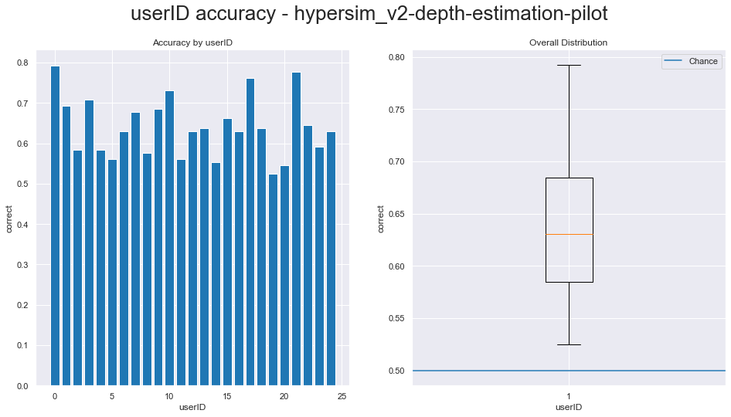
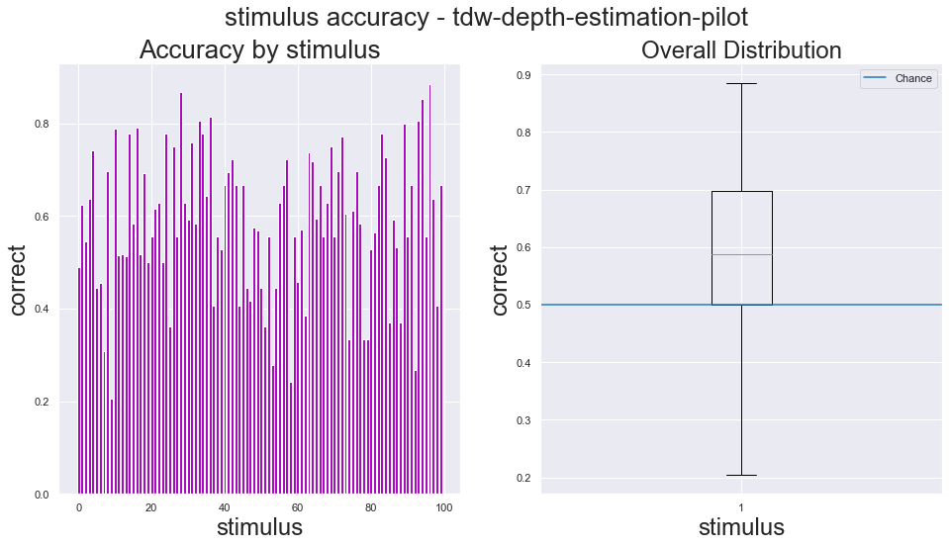
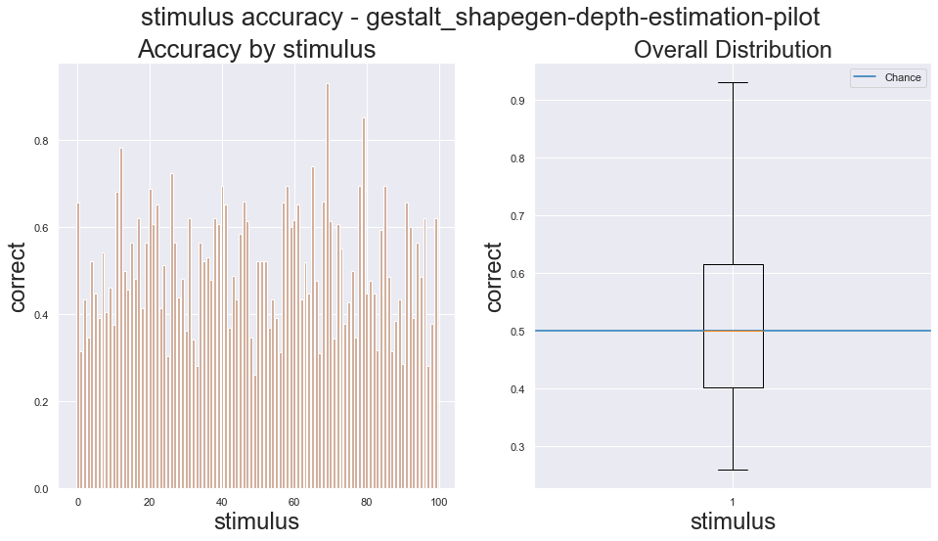
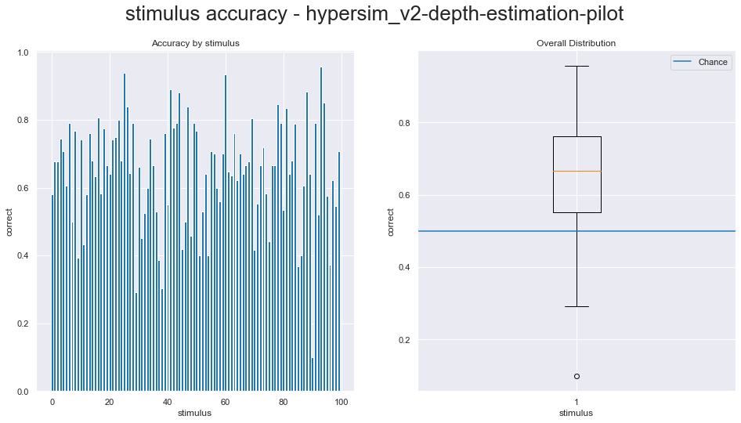
Depth Estimation
TDW - Playroom
Gestalt
Hypersim
Accuracy
Per-Participant
Accuracy
Per-Stimulus
Run split-half depth
Double check distribution of trial depth-differences
Make numbers larger on plots
For Gestalt – get rid of background probe trials

Slide 10
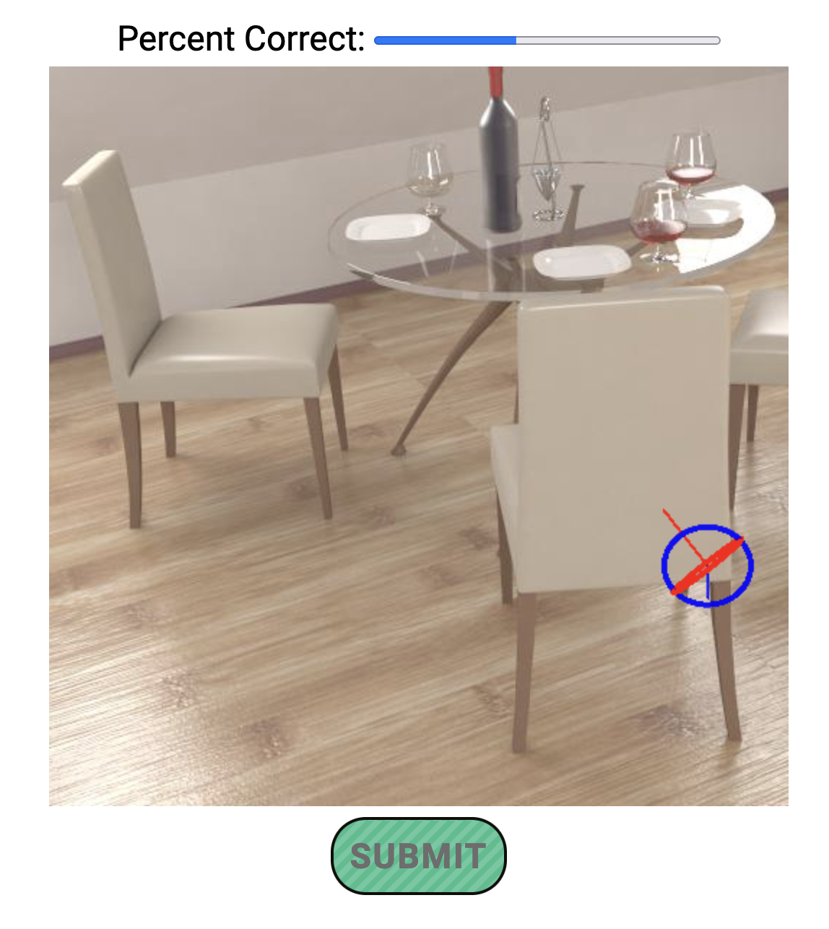
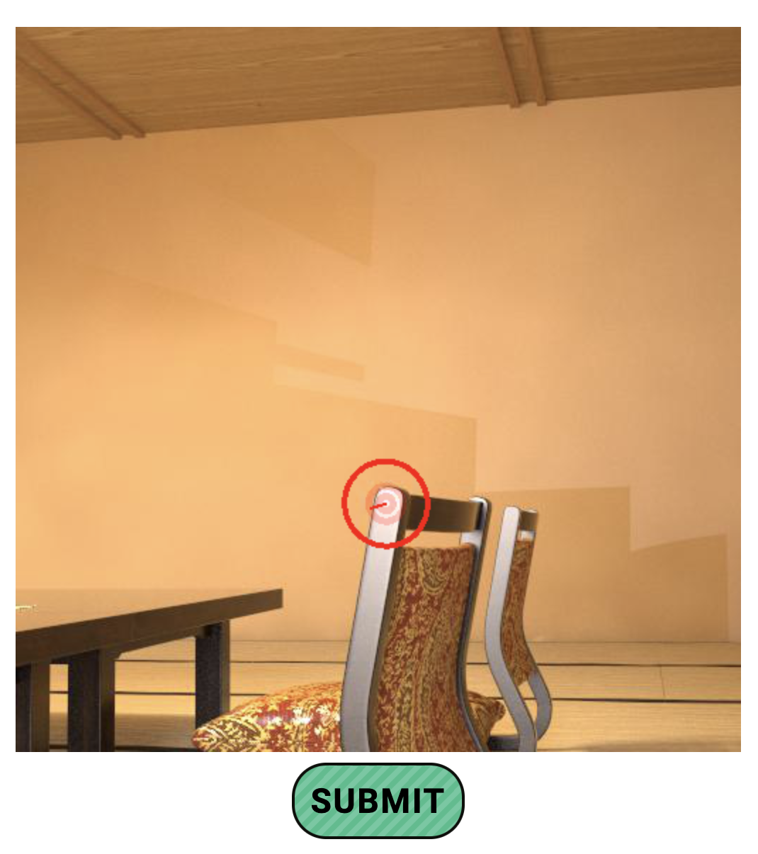
Surface Normal Task
Practice Trial
Test Trial

Slide 11
Visualizing surface normal**
Heatmap on a sphere (much better than 4 days of web engineering)
For TDW – go back and get rid of carpet from sampling points
Plot correlations in a square plot
Double check that there are no bugs there

Slide 12
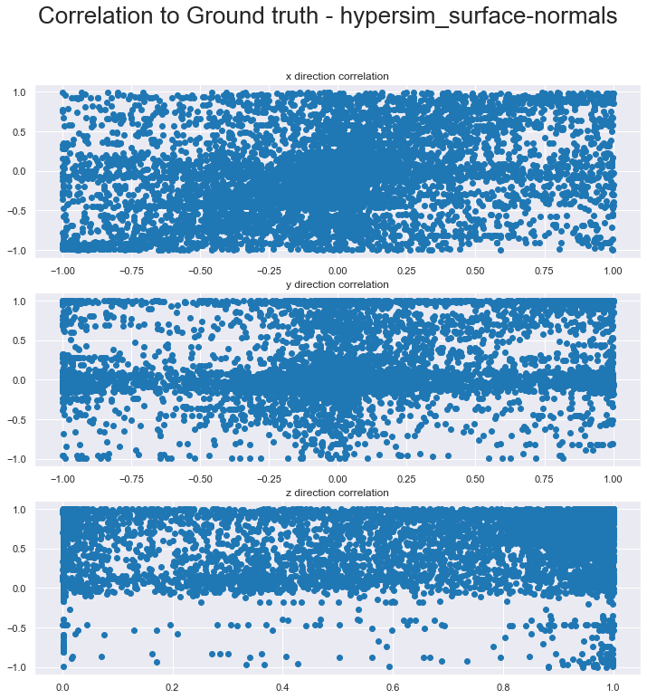
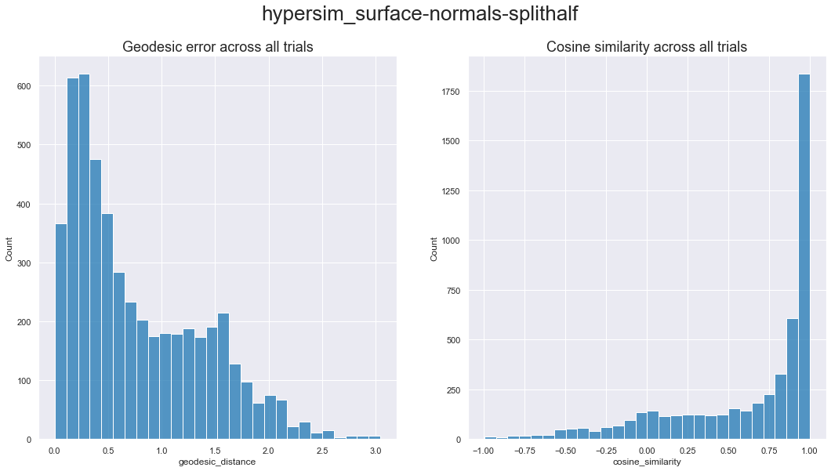
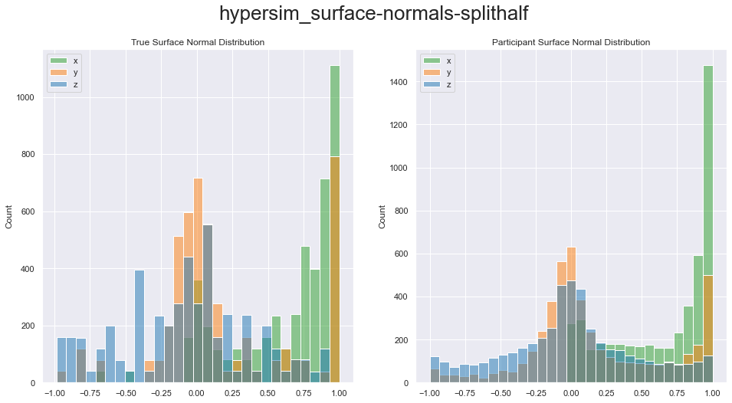
Surface Normals – Hypersim

Slide 13
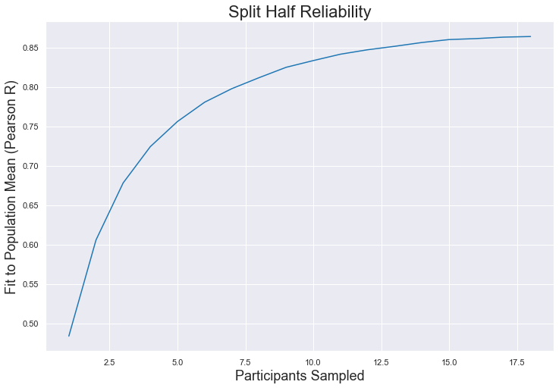
Surface Normal – Noise Estimation (hypersim)

Slide 14
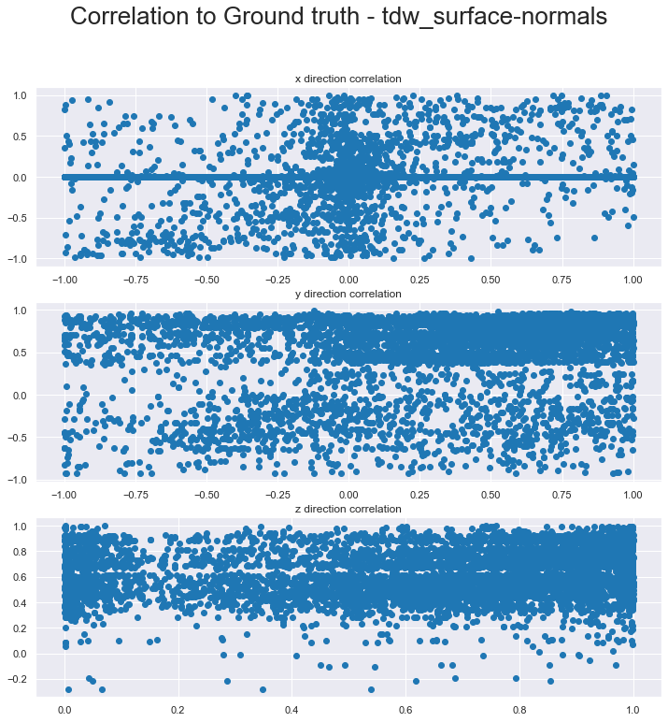
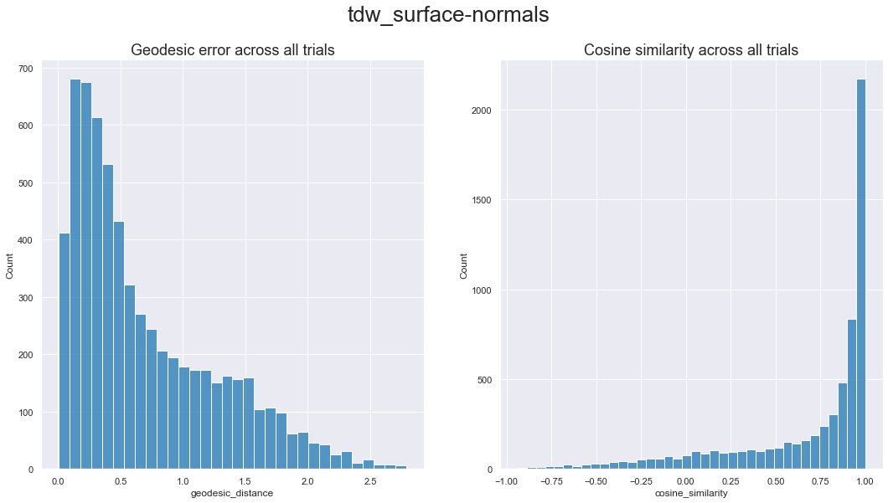
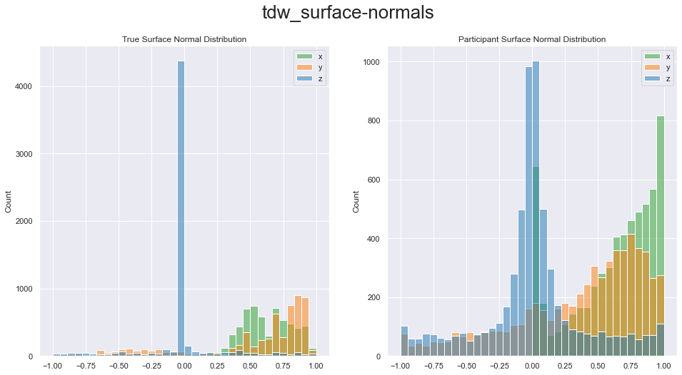
Surface Normals - TDW

Slide 15
Model Plans
What sort of methodology do we use to test them
What are the models that we want to run
2 layers of generality:
Generalize across datasets
Generalize across tasks
Fitting set of image/tasks – use that to train a linear/non-linear readout
CNNs present challenges w/ spatial resolution at various layers
Model Plans
PSGNet
Eisen
Transformers
DINO*
Slot Attention Models
Depth / Normal – specific models

